Slide 1




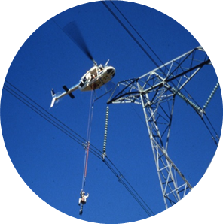
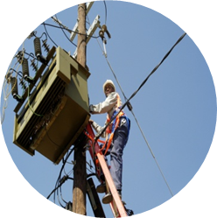
Presentation of Knowledge on Substation Automation
Presented by: Teboho Richard Lekeno
Date: 29 January 2021

Slide 2
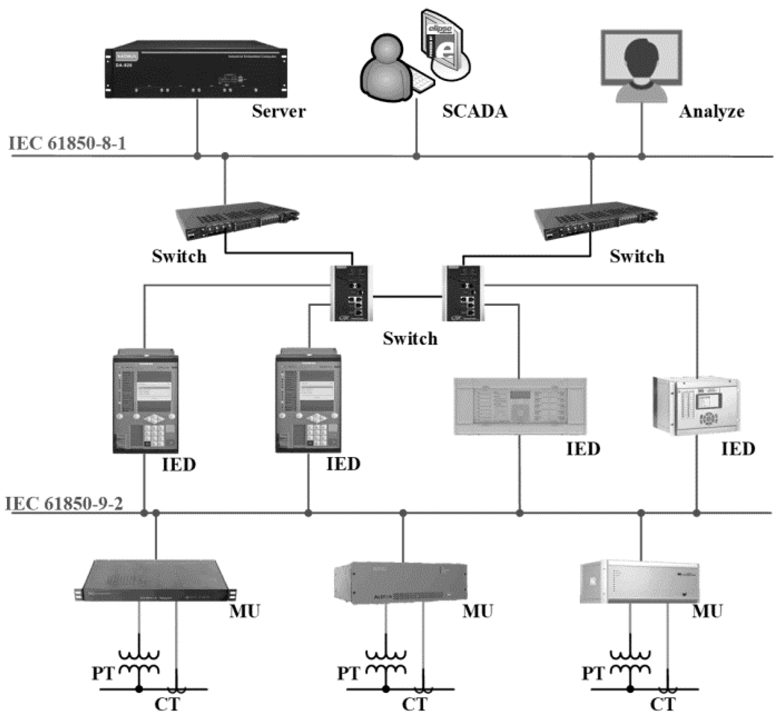
SCADA Network
Supervisory Control And Data Acquisition (SCADA)
Collection of software & hardware
Allows supervisioning & control of plant (locally & remotely)
Examines, collect and process data
SCADA software allows data logging for historical purpose
HMI – interact with field devices

Slide 3
Telecontrol equipment used in Tx & Dx
Gateway – Data concentration, protocol translation, data distribution, logic processing
RTU – conversion between analog and digital signals.
Router – Firewall, cyber security, data distribution
Switches –
GPS – Time synchronization
HMI – single line diagram, Alarm & management, System health information, commissioning tools

Slide 4
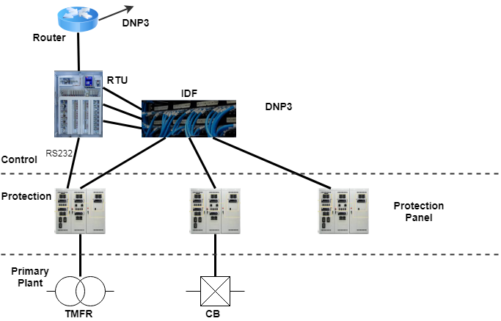
Communication
Distribution Telecontrol Architecture
Communication-DNP3 protocol
Data distribution-DNP3 protocol
Medium
RS232/RS485

Slide 5
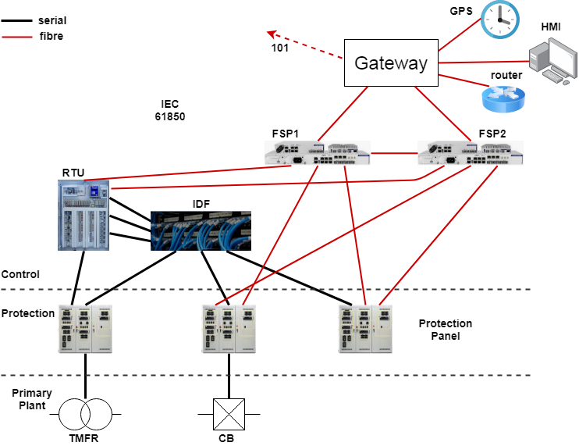
Communication
Transmission Telecontrol Architecture
IEC 101 - Gateway to NCC, DMS & SCC
IEC 61850 – amongst equipment within the control room
Medium
RS232/RS485
Fibre

Slide 6
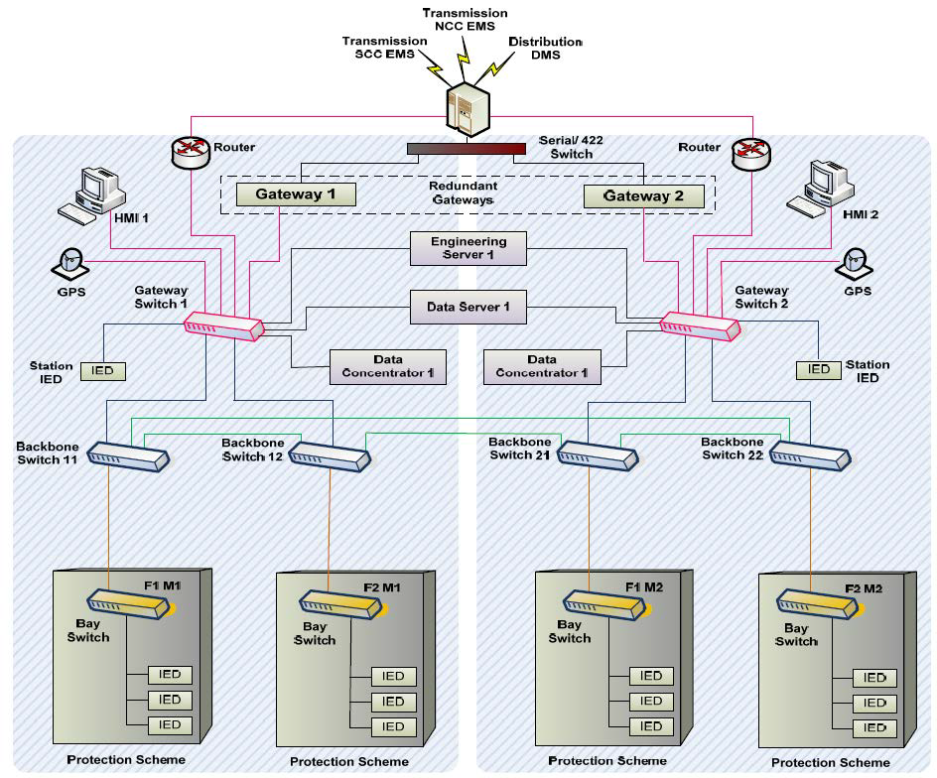
Transmission Telecontrol Architecture
(New Redundant)

Slide 7
Communication Protocols
Protocols Applied at Tx and Dx Substations
1. DNP3 -Distributed Network Protocol 3
2. IEC 61850 (standard)
2.1. MMS – Manufacturing Message Specification
2.2. GOOSE
2.3. SNMP – IP family (request data from data concentrator)
3. Protocol IEC 101

Slide 8
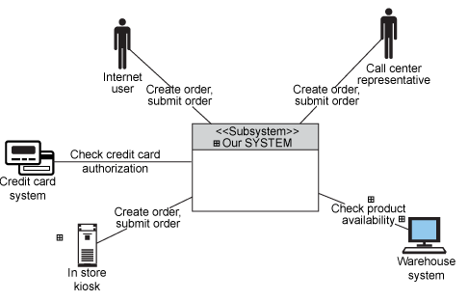
Electric
Operating & Electric Diagrams
Operating
Operating Context Diagram
Process Flow
Single-Line Diagram
Substation layout diagram
Logic Diagram
Wiring diagram

